Slide 1

12
Project Communication and Documentation

Slide 2
Chapter Concepts
Suggestions for enhancing personal communication, such as face-to-face discussions and written communications
Effective listening
Various types of project meetings and suggestions for effective meetings
Formal project presentations and suggestions for effective presentations
Project reports and suggestions for preparing useful reports
Monitoring and controlling changes to project documents
A project communication plan
Communicating with stakeholders
Collaborative communication tools

Slide 3
Learning Outcomes
Discuss and apply techniques to enhance personal verbal and written communication
Describe four barriers to effective listening and apply techniques to improve listening and understanding
Prepare for and facilitate effective project meetings
Prepare for and make informative and interesting presentations
Prepare useful, readable, and understandable reports
Explain how to control changes to project documents
Create a project communication plan
Communicate effectively with project stakeholders
Describe collaborative tools used to enhance communication on projects

Slide 4
Project Communications Management
Project Integration Management
Project Human Resource Management
Project Management Knowledge Areas from PMBOK® Guide

Slide 5
Personal Communication
Verbal Communication
Written Communication
Effective Listening

Slide 6
Verbal Communication
How it takes place
  Face-to-face, via phone, computer, voicemail, videoconferencing
What provides
  Discussion, clarification, understanding, immediate feedback
Elements affecting communication
  Body language
  Cultural differences
When to use
  Early in project, especially face-to-face
  Provide timely communications

Slide 7
Written Communication
How it takes place
  Through e-mail or can be sent hardcopy
What it provides
  Information, confirmation, requests
What it affects
  Length and word choice important
  Media selected – electronic or hard copy
When to use
  When impractical to meet
  Disseminate information in a timely manner

Slide 8
Effective Listening
Barriers to Effective Listening
How Improve Listening Skills
Pretending to listen
Distractions
Bias and closed-mindedness
Impatience
Jumping to conclusions
Focus on the person talking
Engage in active listening—provide verbal and nonverbal feedback
Ask questions
Do not interrupt

Slide 9
Meetings
Most common types
  Project kickoff meeting
  Status review meetings
  Problem-solving meetings
  Design review meetings
  Post-project evaluation meeting

Slide 10
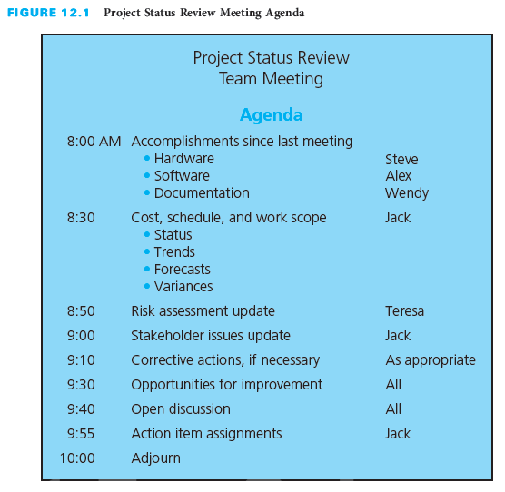
Status Review Meetings
Purpose
  Inform
  Identify problems
  Identify action items
Frequency
  Regularly scheduled

Slide 11
Problem-Solving Meetings
Follow problem solving approach
  Develop a problem statement
  Identify potential causes of the problem
  Gather data and verify the most likely causes
  Identify possible solutions
  Evaluate the alternative solutions
  Determine the best solution
  Revise the project plan
  Implement the solution
  Determine whether the problem has been solved
Purpose
  Address problems that have been identified
Frequency
  When a potential problem is identified

Slide 12
Design Review Meetings
Purpose
  Review design plans
  Confirm customer approval
Frequency
  Preliminary design review as needed
  Final design approval needed
Not every project has design review
Required to ensure customer approval

Slide 13
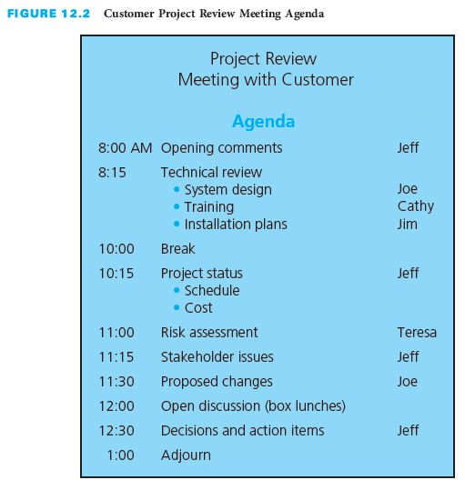
Before the Meeting
Necessary?
Purpose?
Participants?
Distribute agenda
Prepare materials

Slide 14
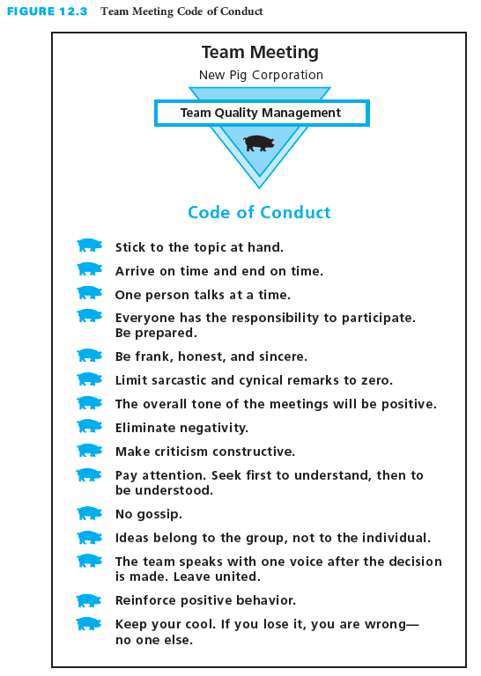
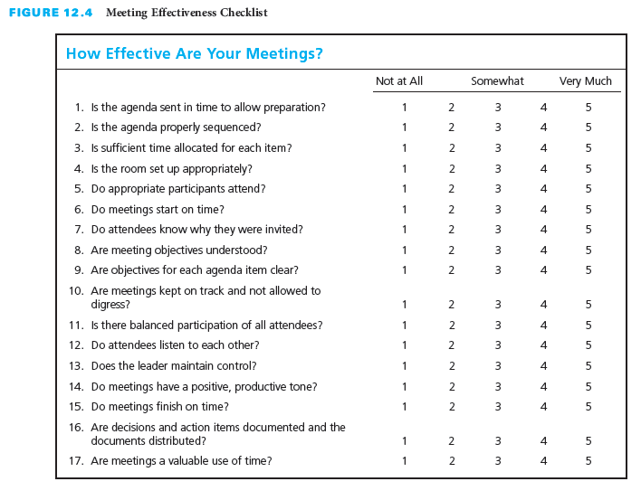
During the Meeting
Start on time
Designate note taker
Reduce distractions
Review purpose
Facilitate discussion
Summarize
Evaluate process

Slide 15
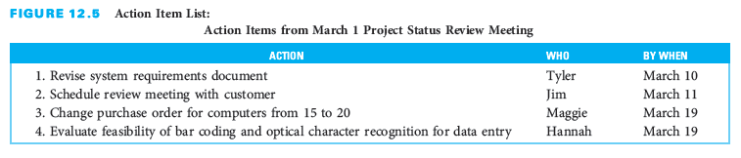
After the Meeting
Publish minutes
Summarize to one page
Confirm decisions
List action items

Slide 16
Presentations
Prepare
Deliver
Inform or Persuade?
Audience?
Make outline
Use clear language
Prepare notes and materials
Practice, practice, practice
Copy handouts
Request audiovisuals
Visit meeting room
Expect nervousness
Remove distractions
Memorize opening lines
Use 3-T approach
Present professionally
Summarize points
Memorize closing lines
Interact with audience when appropriate

Slide 17
Reports
Progress Reports
Final Report
Not an activity report
Covers a specific period, the reporting period
Might include
  Accomplishments
  Current status
  Progress toward resolution of problems
  Problems or potential problems and corrective actions
  Milestones for next period
Should not be a surprise
Summary of the project
Might include
  Original need, objective, requirements
  Description
  Degree met
  Actual benefits
  Future considerations
  Deliverables
  Test data from the final-acceptance testing

Slide 18
Control Document Changes
Revisions
  From customer or team
  Approval by customer and team
Latest version
Distribution plan
Revision summary
REV. 4. 12/29/17, ES

Slide 19
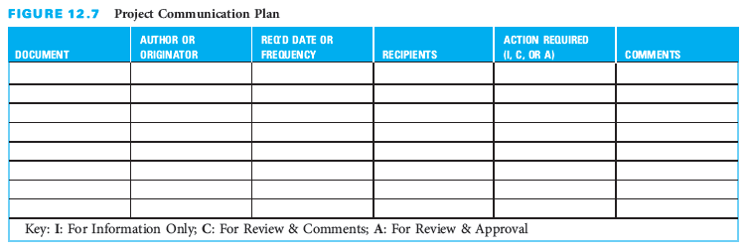
Project Communication Plan
Possible Elements
Template
Documents
Author or originator
Required date or frequency for document completion and distribution
Recipients for documents in distribution list
Actions required
Comments related to each document

Slide 20
Stakeholder Communication
Welcome stakeholder input, involvement, discussions, and debate
Employ effective verbal and written communication
Address concerns early, positively, and in a timely manner
Provide opportunities for regular two-way communication

Slide 21
Collaborative Communication Tools
Why Use?
Collaboration tools
Face-to-face not always feasible
Dispersed teams
Involve others in decision making
Document management
Dedicated storage space
Share documents and data
Email
Teleconferencing and videoconferencing
Web 2.0 tools
Groupware
Document and content management systems
Extranets
Collaborative project workspaces on the web

Slide 22
Critical Success Factors
Effective and frequent personal communication is crucial to successful project management.
A high degree of face-to-face communication is important early in the project to foster team building, develop good working relationships, and establish mutual expectations.
Body language and customs reflective of cultural diversity must be considered in communications.
Be careful not to use remarks, words, or phrases that can be construed to be sexist, racist, prejudicial, or offensive.
The heart of communication is understanding—not only to be understood, but to understand. Half of making communication effective is listening. Failure to listen can cause a breakdown in communication.
Communication should be frequent, timely, clear, concise, honest, unambiguous, free of jargon, and not offensive.

Slide 23
Critical Success Factors (continued)
Achieving customer satisfaction requires ongoing communication with the customer to keep him or her informed and to determine whether expectations have changed. Regularly ask customers about their level of satisfaction with the progress of the project.
Keep the customer and project team informed of the project status and potential problems in a timely manner.
Project status meetings should be held on a regular basis. Have the team develop meeting guidelines at the project kickoff meeting at the beginning of the project so that everyone understands and is committed to what behavior is expected during project meetings.
Do not confuse busyness and activity with accomplishment when communicating project progress.
Reports must be written to address what is of interest to the readers, not what is of interest to the person writing the report.

Slide 24
Critical Success Factors (continued)
Make reports concise, readable, and understandable. Pay as much attention to format, organization, appearance, and readability as you do to the content.
At the start of the project, a document control system needs to be established that defines how changes to documents will be documented, approved, and communicated.
When documents are updated, they should immediately be distributed to all team members whose work will be affected.
At the beginning of the project, prepare a project communication plan to ensure that all stakeholders will receive the information and documents they need.
Regular and open communication, trust, respect, open-mindedness, and a positive win-win attitude are keys to successful stakeholder engagement.

Slide 25
Summary
Project communication takes various forms.
  Face-to-face or via some medium
  Verbal or written
  Internal or external correspondence
Body language and tone are important elements in verbal communication.
Failure to listen can cause a breakdown in communication.
The three most common types of project meetings are status review, problem-solving, and design review meetings.
Before any meeting, the purpose of the meeting and the people who need to participate should be determined, an agenda drawn up and distributed, materials prepared, and room arrangements made.
In preparing for the presentation, it is important to determine the purpose of the presentation, find out about the target audience, make an outline, develop notes and visual aids, make copies of handout materials, and practice.

Slide 26
Summary (continued)
Written progress reports and final reports are often required during a project.
At the start of the project, a document tracking system needs to be established regarding how changes to documents will be documented, approved, and communicated.
A project communication plan defines the generation and distribution of project documents among stakeholders throughout the project.
Communicating with stakeholders requires the project team to employ effective verbal and written communication, and in particular effective listening to achieve understanding
Collaborative communication tools allow all or some of the members of the project team, including subcontractors and the customer to communicate with each other.

